Slide 1
HearMe
AI Based Emergency Website
TEAM NAME
Alpha Coder’s
TEAM MEMBERS
Priyanshu Singh – Leader
Amarjeet Singh
Shivansh Swami
Tanav Singh

Slide 2
PROJECT: HearMe
Hands-Free Emergency Detection System
An AI-powered mobile application that detects emergency situations through voice keywords and automatically triggers help.

Slide 3
PROBLEM STATEMENT
Real-World Problem
During emergencies such as accidents, medical attacks, or assaults:
Users cannot unlock phones
Apps require manual interaction
Panic prevents quick response
❌ Existing emergency apps fail because they depend on button clicks and internet access.

Slide 4

PROPOSED SOLUTION
Our Solution
An AI-based mobile application that:
Continuously listens in the background
Detects emergency keywords in human voice
Automatically triggers help without user interaction
✅ No clicks. No typing. Just speak.

Slide 5
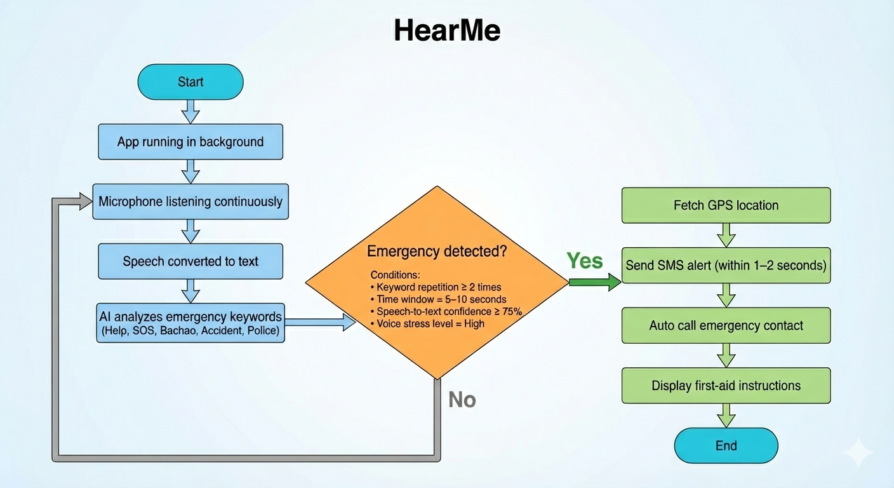
HOW THE SYSTEM WORKS
System Workflow
App listens to microphone in background
Speech is converted to text
AI analyzes keywords and voice stress
Emergency is confirmed
Location is shared and help is triggered

Slide 6
AI LOGIC FLOW
AI Decision Process
Audio Input
Speech-to-Text Conversion
Keyword & Confidence Analysis
Emergency Confirmation
Automatic Action Trigger

Slide 7

EMERGENCY KEYWORDS
Detected Keywords
Help
SOS
Bachao
Accident
Police
The system checks for repetition, stress level, and confidence score before triggering alerts.

Slide 8
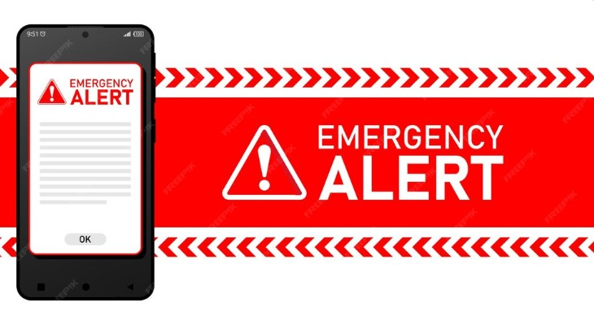
FALSE ALARM PREVENTION
How False Alerts Are Avoided
✔ Keyword must be repeated
✔ Voice must indicate stress or panic
✔ Time window validation (5–10 seconds)
✔ Confidence threshold check
A single casual word does not activate emergency mode.

Slide 9
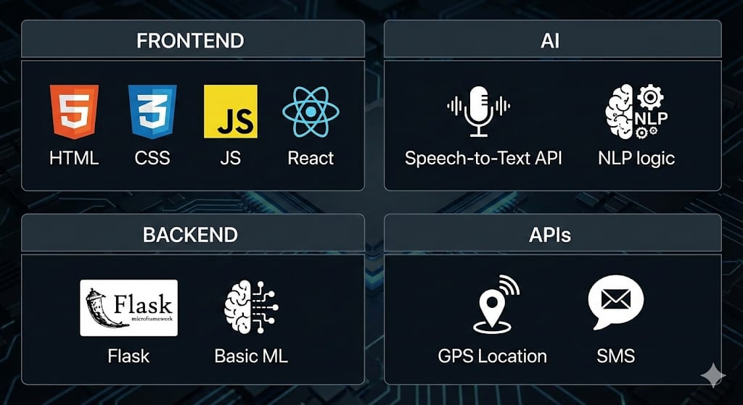
TECHNOLOGY STACK
Tech Stack Used
Frontend: HTML, CSS, JS, React
AI: Speech-to-Text API, NLP logic
Backend: Flask, Basic ML
APIs: GPS Location, SMS

Slide 10
ADVANTAGES & IMPACT
Why This Project Matters
✔ Works hands-free
✔ Saves critical response time
✔ Minimal user effort
✔ High real-world impact
✔ Hackathon-friendly implementation
A simple solution designed to save lives.

Slide 11
CONCLUSION
The HearMe provides a fast, reliable, and intelligent way to seek help during emergencies using only voice commands — when every second matters.

